Slide 1
American cultural
values

Slide 2

We hold these truths to be self-evident, that all men are created equal, that they are endowed by their Creator with certain unalienable Rights, that among these are Life, Liberty and the pursuit of Happiness.
-----Declaration of Independence
note: Unalienable mainly appears in quotes of or references to the Declaration. Inalienable prevails everywhere else

Slide 3
我们认为下面这些真理是不言而喻的：人人生而平等，造物者赋予他们若干不可剥夺的权利，其中包括生命权、自由权和追求幸福的权利。
“all men are created equal”？

Slide 4
Learning objectives
Know the origins of American cultural values.
Learn the core American values like individual freedom, equality and material wealth.
Learn traditional and core socialist Chinese values.

Slide 5
The origins of American cultural values
The ingredients of American character have been traced to many sources:
Basic value: the concept of natural rights, the Constitution→ individual freedom / individualism; Frontier → rugged individualism
Religion:
Calvinism→ Protestantism
Politics:
Anglo-Saxon civil rights, rule of law, representative institutions and French egalitarian democracy
Note: rugged individualism: the practice or advocacy of individualism in social and economic relations emphasizing personal liberty and independence, self-reliance, and free competition in enterprise

Slide 6
Basic American cultural values
individual freedom/ individualism:
1. origin and understanding 2. individualist vs collectivist cultures
3. self-reliance (the cost of individual freedom) 4. double edge of individualism
equality of opportunity:
1. origin and understanding 2. two related terms: self-made; from rags to riches 3. competition (the cost of equality of opportunity)
material wealth:
1. material wealth/ possessions as a basic value, slogan for the American dream
2. hard work (the way to gain material wealth)+ the Protestant work ethic
3. American dream

Slide 7
1.1 Individual freedom
By limiting the power of the government and the churches and eliminating a formal aristocracy [ˌærɪˈstɒkrəsi] ( nobility, gentry) （the Constitution), the early settlers created a climate of freedom where the emphasis was on the individual.
Thus, individual freedom became the most basic of all the American values. Scholars often call this value individualism, while many Americans use the word freedom .
How to define freedom?
The desire and the right of all individuals to control their own destiny without outside interference from the government, a ruling noble class, the church and any other organized authority.
Notes:
Climate: the general atmosphere or situation: e.g. The economic climate 经济形势

Slide 8
As social conditions become more equal, the number of persons increases who, although they are neither rich nor powerful enough to exercise any great influence over their fellows, have nevertheless acquired or retained sufficient education and fortune to satisfy their own wants. They owe nothing to any man, they expect nothing from any man; they acquire the habit of always considering themselves as standing alone, and they are apt to imagine that their whole destiny is in their own hands.
---- Alexis de Tocqueville Democracy in America

Slide 9
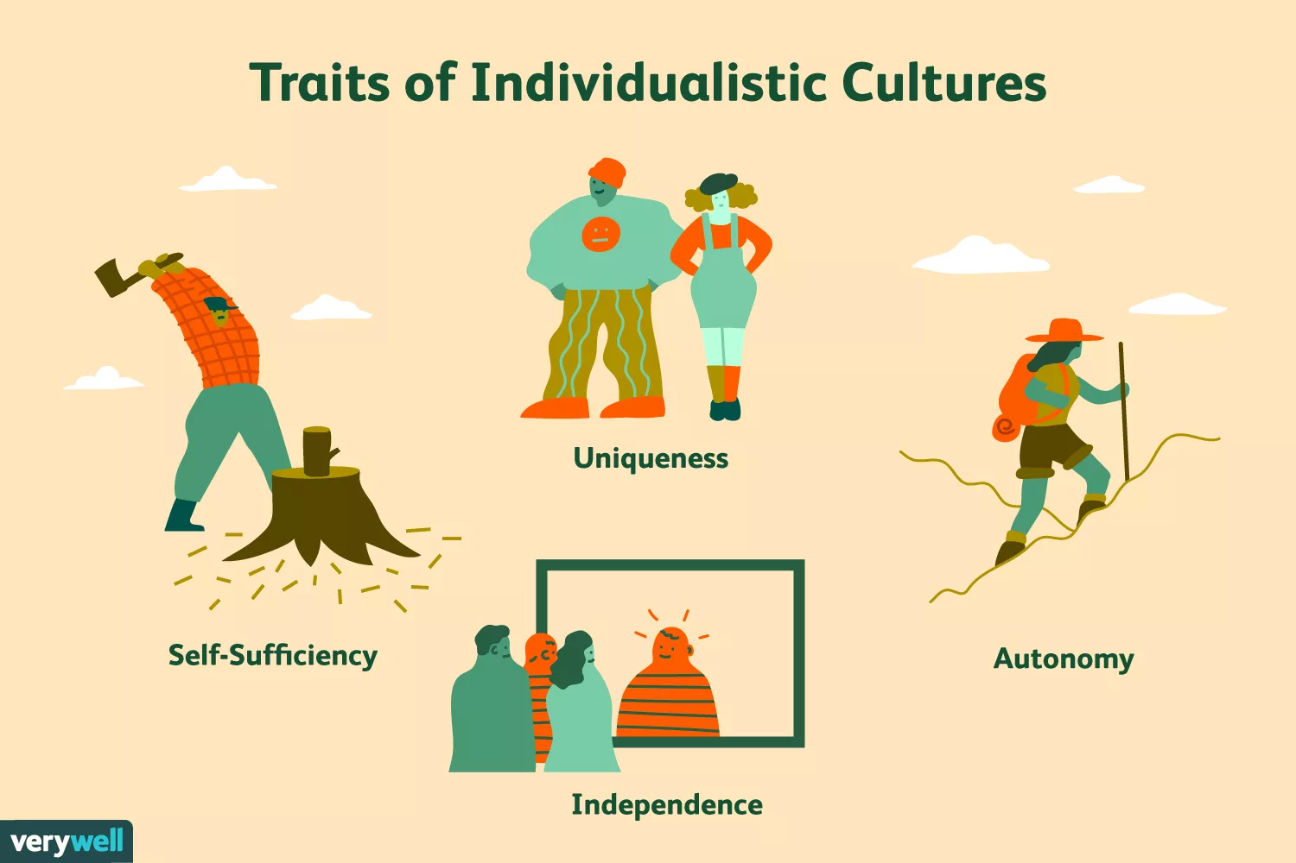
Individualistic Culture Traits
A few common characteristics of individualistic cultures include:
Being dependent upon others is often considered shameful or embarrassing
Independence is highly valued
Individual rights take center stage
People often place a greater emphasis on standing out and being unique
People tend to be self-reliant
The rights of individuals tend to take a higher precedence [ˈpresɪdəns]
Notes:
Autonomy [ɔːˈtɒnəmi] : the ability to act and make decisions without being controlled by anyone else 自主权

Slide 10
1.2 Individualist vs. Collectivist Cultures??
Individualist cultures are frequently compared and contrasted with more collectivist cultures. Where collectivism stresses the importance of the group and social cooperation, individualism prizes things such as autonomy, independence, self-sufficiency and uniqueness.
Where people in collectivist cultures might be more likely to turn to family and friends for support during difficult times, those living in individualist cultures are more likely to go it alone.
Workers in an individualist culture are more likely to value their own well-being over the good of the group. Contrast this with a collectivist culture where people might sacrifice their own comfort for the greater good of everyone else.
The Wandering Earth 2: self-sacrifice

Slide 11
1.3 Individual freedom and self-reliance
The price to be paid for individual freedom is ?
Self-reliance
Traditionally, self-reliance has meant ___________.
achieving both financial and emotional independence from parents as early as possible.
Discussion:
As a college student and an adult, do you think it is important to be self-reliant? Why or why not? Are there any feasible ways for you to gain financial independence?

Slide 12
1.4 The double edge of individualism
Definition of individualism: a doctrine that the interests of the individual are or ought to be ethically paramount
The positive image of individualism: ??
Self-reliant individual responsible for whatever he does
The positive picture of American individualism: ??
Opportunity for the individual, grant of freedom and encouragement of diversity
To keep the vitality of the nation, Americans should carry on this individual spirit…
Notes:
Paramount：more important than anything else

Slide 13
1.4 The double edge of individualism
The negative side of individualism:??
1. Overriding concern with the individual and the pursuit of self-interest may hurt the interests of others.
In this preoccupation with his own rights, individuals tend to develop two kinds of indifference: ??
Indifference to the preservation of natural resources and indifference to those who fall behind in the race for survival
2. Unchecked individualism can bring chaos and disorder to the society.
Notes:
Overriding: more important than anything else

Slide 14
2.1 Equality of opportunity
In the "old country", place in life was determined largely by the social class into which they were born.
While titles of nobility (duke, marquis, earl, viscount, baron in the UK) were forbidden in the Constitution, immigrants believed that each individual should have an equal chance for success.
Lincoln said in the 1860s: We …wish to allow the humblest man an equal chance to get rich with everybody else.

Slide 15
2.2 self-made, from rags to riches
Discuss the following two terms which are related to equality of opportunity.
1. self-made 2. from rags to riches
Group work/ speaking task：self-made entrepreneur
Work in groups: each member tells the story of a famous self-made entrepreneur or the whole group tell the story of a self-made entrepreneur your group members admire. The following information can be included:
The life story of the entrepreneur
What you can learn from him/her or what qualities make/ made him/her successful
What you admire most about him/her, why

Slide 16
2.3 Equality of opportunity and competition
So fierce is competition that everyone has to constantly sharpen his or her competitive edge.
Learning to compete successfully is part of growing up in the US.
However:
Old people in the US don’t have as much respect as they have in less competitive societies because ??
The American Continent is a paradise for the young, a life-struggle field for the middle-aged, and a hell for the elderly.

Slide 17
Equality of opportunity and competition
Q: Cooperation or competition, which do you value more, why?
Writing assignment:
Many students are taught to push themselves to try and be better than other students, rather than work together for everyone's benefits. Do the advantages outweigh the disadvantages?
(Refer to IELTS writing PPT or the sample for the overall organization of IELTS argumentative writing.)

Slide 18
1.登录批改网：www.pigai.org
2. 查找作文号：2818789
3. 提交作文
Deadline: 2023-04-15 23:59

Slide 19
Sports encourage competition rather than cooperation. Therefore, sports should not be encouraged at school. To what extent do you agree or disagree with the statement?
Sports enrich students campus life and energize their physiques. Faced with immense pressure from work and study, more and more people begin to realize the importance of physical training. However, there is a heated debate over whether sports should be encouraged in school. As for me, I cannot see any contradiction between cooperation and competition.
On the one hand, competition is the driving force of social progress. Without exception, the development of athletics attributes mainly to the competition in sports. Competition, the motivation of athletic development, not only stimulates athletes desire for winning a game, but also entertains the audience. If there is no competition in sports, NBA games, for instance, will not be that attractive and exciting.
On the other hand, competition is not the decisive factor to win a game. Some sports games such as football, basketball and boat racing require cooperation, and without which, some athletes and sports stars will not be so brilliant. The World Cup gives us a very convincing illustration. Soccer, an overwhelming team game in the world, implies both fantastic individual skills and good cooperation between the players. Therefore, sports can cultivate pupils team spirit and strengthen unity of a class.
To sum up, competition does not result in hatred between rivalries as expected. On the contrary, it plays a very active role in the building-up of friendship and the relationship between the people from different races, religions, cultures and political backgrounds. Personally, I advocate the encouragement of sports at school because sports benefit students both physically and psychologically. (256 words)

Slide 20
3.1. Material wealth
Which phrase became a slogan for the "American Dream"? What became a value to the American people?
Going from rags to riches, material wealth
A person’s importance and status are largely determined by the money he or she earns.
Q: how to gain material wealth?

Slide 21
3.2 Material wealth and hard work
Americans have seen material possessions as the natural reward for their hard work.
The Protestant Work Ethic:
the belief in hard work and self-discipline in pursuit of material wealth and other goals.
Famous quotes:
“Genius is one percent inspiration and ninety-nine percent perspiration.” ----??
“I'm a great believer in luck, and I find the harder I work the more I have of it.”---- Thomas Jefferson
individualism and the work ethic.docx

Slide 22
3.3 American dream
What is the American dream?
If they word hard, they and their children can have a better life.
The term was first used by James Truslow Adams in his book The Epic [ˈepɪk] of America which was written in 1931. He states: "The American Dream is "that dream of a land in which life should be better and richer and fuller for everyone, with opportunity for each according to ability or achievement…. It is not a dream of motor cars and high wages merely, but a dream of social order in which each man and each woman shall be able to attain to the fullest stature[ˈstætʃə(r) ] of which they are innately [ɪ'neɪtlɪ] capable, and be recognized by others for what they are, regardless of the fortuitous [fɔ:ˈtju:ɪtəs] 偶然的 circumstances of birth or position."

Slide 23
Comparison between American and Chinese cultural values
Traditional American cultural values
1. Individual freedom and self-reliance
2. Equality of opportunity and competition
3. Material wealth and hard work
4. slogan for the American dream:
going from rags to riches

Slide 24
Comparison between American and Chinese cultural values
Traditional Chinese values
1. The core value is harmony
2. Five cardinal virtues by Confucius:
benevolence [bə'nevələns]: the core value of Confucianism
righteousness ['raɪtʃəsnəs]： justice and correctness
courtesy [ˈkɜ:rtəsi]：modesty and prudence
wisdom：Benevolence means to love and wisdom means to understand others （仁者爱人，智者知人）
honesty：trustworthiness, integrity, and credibility
(loyalty： faithfulness to family, friends and the motherland)
3 . filial piety:
Filial piety is the most important of all virtues.

Slide 25

Core socialist values

Slide 26
Core socialist values
富强 民主 文明 和谐
prosperity democracy civility harmony
自由 平等 公正 法治
freedom equality justice the rule of law
爱国 敬业 诚信 友善
patriotism dedication integrity friendliness
[ˈpeɪtriətɪzəm] [ɪnˈteɡrəti]

Slide 27
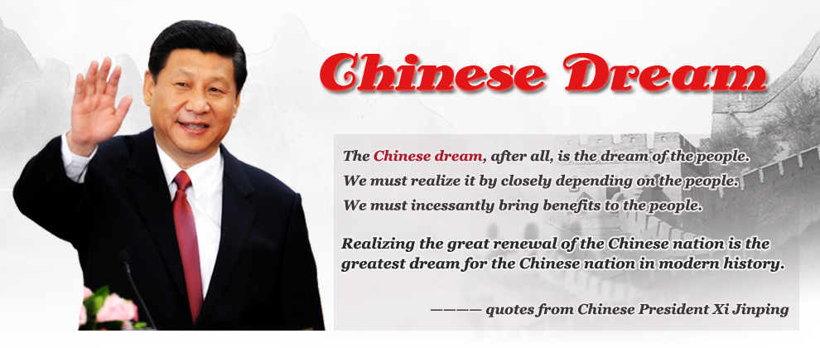
Chinese/ China Dream
Is there a Chinese/China dream?
What is your Chinese dream? How can it be realized?

Slide 28
Chinese dream/ China dream
江山就是人民，人民就是江山。中国共产党领导人民打江山、守江山，守的是人民的心。
This country is its people; the people are the country. As the Communist Party of China has led the people in fighting to establish and develop the People's Republic, it has really been fighting for their support.

Slide 29
Key points: basic American cultural values
1. individual freedom/ individualism:
By limiting the power of the government and the churches and eliminating a formal aristocracy [ˌærɪˈstɒkrəsi] ( nobility, gentry) （the Constitution), the early settlers created a climate of freedom where the emphasis was on the individual.
The price to be paid for individualism is self-reliance which means achieving both financial and emotional independence from parents as early as possible.
double edge of individualism

Slide 30
Key points: basic American cultural values
2. equality of opportunity:
While titles of nobility (duke, marquis, earl, viscount, baron in the UK) were forbidden in the Constitution, immigrants believed that each individual should have an equal chance for success.
3. material wealth:
material wealth/ possessions as a basic value
slogan for the American dream : going from rags to riches
Americans have seen material possessions as the natural reward for their hard work.
The Protestant Work Ethic:
the belief in hard work and self-discipline in pursuit of material wealth and other goals.

Slide 31
Supplementary reading: individualism and rugged individualism
Individualism
Individualism is the core of American values. It has been the primary force of American civilization for more than two centuries. It is individualism that has supplied the motivation of American political，economic and spiritual institutions in the history of its development.
Individualism is originated to the great English scholar John Locke’s doctrine of separation of powers in the 17th century. Locke’s doctrine mainly emphasized on the individual rights, which affected one of the United States' founders，Thomas Jefferson，pretty much. Until the year of 1840， a French political commentator Alexis de Tocqueville coined the word “individualism”.

Slide 32
According to Encyclopedia Britannia，individualism is a kind of political and social philosophy that places high value on the freedom of the individual and generally stresses the self-directed, self-contained, and comparatively unrestrained individual or ego. Another authoritative dictionary，American Heritage Dictionary， defines individualism in the following three points： Belief in the primary importance of the individual and in the virtues of self-reliance and personal independence；A doctrine of freedom from government regulation of personal economic or social goals；The doctrine that the interests of the individual should take precedence over the interests of the group.

Slide 33
Rugged Individualism
Rugged Individualism (Frontier culture in America) was first presented as an important historical event at a meeting of the World Congress of Historians held in Chicago in the summer of 1893. A young professor from the University Wisconsin named Frederick Jackson Turner read his social analysis entitled "The Significance of the Frontier in American History." In it, he told Americans they were a rugged, self-made race of men, forged in adversity through the pioneering experience, reborn and purified into a breed unique on earth.
In the 1928 Presidential election, Herbert Hoover, the 31st president of the United States, was campaigning against Democrat Alfred Smith. As the election came to a close, Hoover sought to define his own philosophy, made famous in the speech entitled 'Rugged Individualism.' Herbert Hoover's definition of rugged individualism was freedom from government intervention and focus on individual entrepreneurship, enterprise, and volunteerism.

Slide 34
In this campaign speech, he espouses the belief that the government should not become overly involved in American commerce and business, though he does not advocate for a complete laissez-faire system. Hoover specifically states:
"Nor do I wish to be misinterpreted as believing that the United States is free-for-all and devil-take-the-hind-most [haɪnd]. The very essence of equality of opportunity and of American individualism is that there shall be no domination by any group or combination in this Republic, whether it be business or political. On the contrary, it demands economic justice as well as political and social justice. It is no system of laissez-faire.“
Notes:
1. free for all: a situation in which there are no rules or controls and everyone acts for their own advantage 自由放任
2. devil take the hind most (saying) everyone should look after themselves and not care about others

